Slide 1
Nomenclature of Polyfunctional Compounds
Monali M. Shewale
Assistant professor
Department of Pharmaceutical Chemistry
Krishana Institute of Pharmacy, Karad.

Slide 2
Contents
Rules for nomenclature of polyfunctional compounds
Rules for nomenclature of cyclic compounds

Slide 3
Organic compounds having two or more functional groups are called as polyfunctional compounds. While doing the nomenclature by IUPAC system of polyfunctional compounds one of the functional groups is taken as key functional group even as remaining functional groups are treated as substitutents . The priority of functional are as as following :

Slide 4
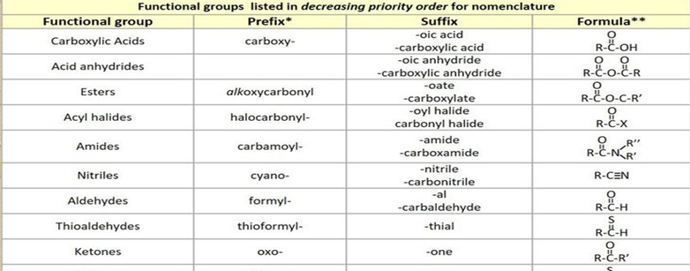

Slide 5
Substitutive naming of halogen compounds are formed by adding the prefixes ‘fluro’, chloro , bromo , or iodo to the name of parent compound .
Groups which may be named only as prefixes
If there is choice between the two halide for numbering, alphabetical order is followed .

Slide 6
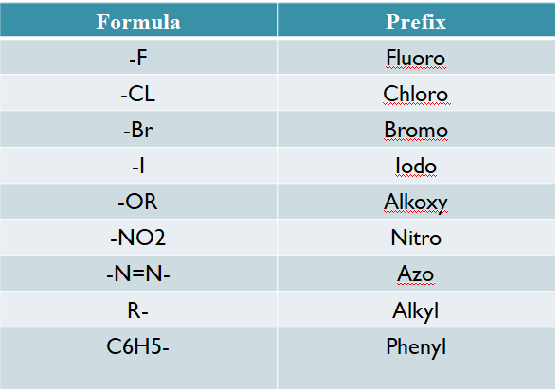

Slide 7
1) select the key functional group and the parent chain having maximum number of functional groups .
2) start the numbering so that the key functional group is nearer and should be lowest numbered .
3) other substituents added as a prefix in alphabetical order.
4) as already discussed some of the functional groups are always treating as substitutents hence they are written as prefix with the parent name .
5) if the compounds having both double bond and triple bond then numbering will be carried out using lowest number rule . If both were given the same number , then preference will be given to double bond and such compounds are named as alkynes

Slide 8
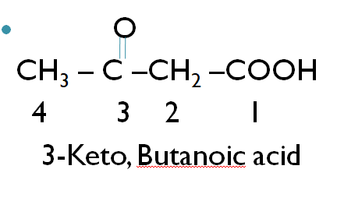
Arrangement of prefixes :
6) The prefix such as di , tri etc. are not considered in alphabetical order other substituents are arranged alphabetically .
7) if the two substituents are having the same position , then the lowest number is given to the substituents in alphabetical order .

Slide 9
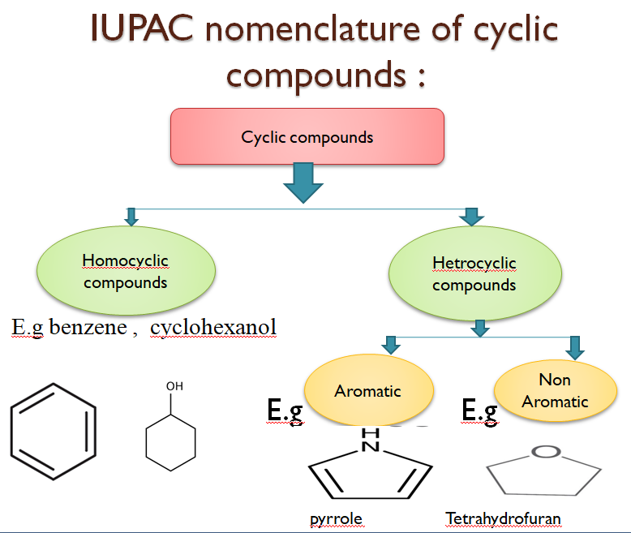

Slide 10
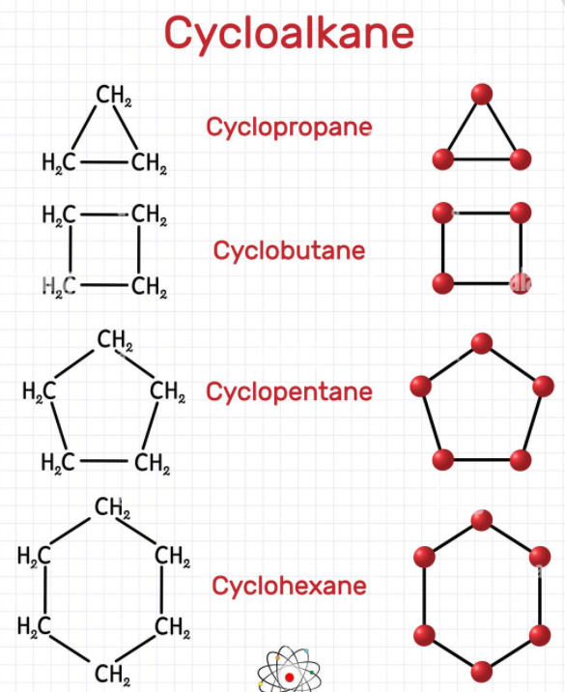
Rules :
1) In the cyclo alkanes, the alkanes are arranged in a ring . They are named as cyclo before the name of alkane .

Slide 11
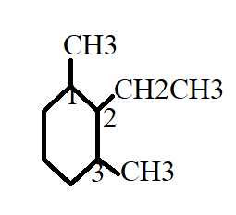
2.) The naming of substituted cycloalkanes, the name of substituents is prefixed to the name of cycloalkane.But if more than one substituents is present than numbering of C – atom in the ring is done in such way that the substituents which is alphabetically lowered should be given lowest number , but it should follow the lowest sum rule .
2-Ethyl,1,3-Dimethyl cyclohexane

Slide 12
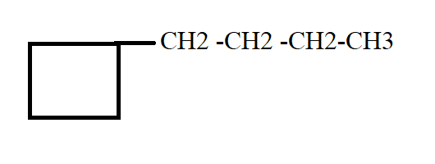
3) when the ring containing equal no of carbon atom than the substituent will be alkyl group. The alkyl group is named as the derivative of cycloalkane and alkyl group as substituent .
Butyl cyclobutane

Slide 13
THANK
YOU

